Slide 1
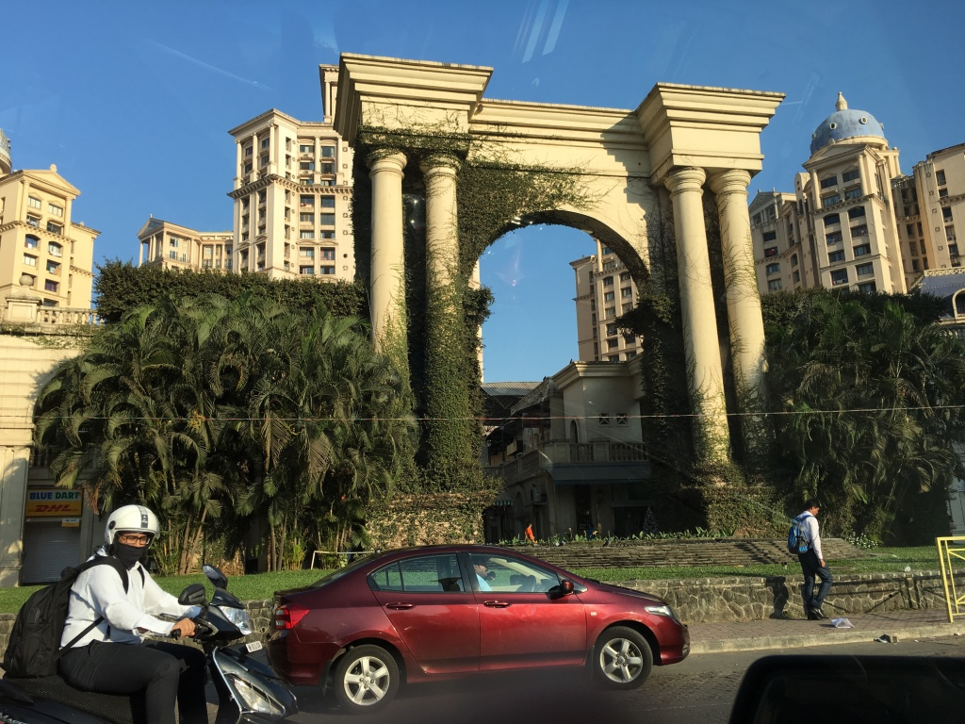
WCTRS General Assembly
IIT Bombay, 28th May 2019, 14:30-16:10

Slide 2
Agenda
Welcome (Secretary General)
Dupuit Prize Awarding (Dupuit Prize Committee – ADM)
Minutes of the General Assembly held 12 July 2016 at Tongji University, Shanghai (President WCTRS - YH)
President Report on the Society’s professional activities 2016/2019 (YH)
SCC Chair Report on the Innovations in Scientific Matters (LT)
Editor-in-Chief Report on Transport Policy (TO)
WCTRS General Assembly – Mumbai 2019 2

Slide 3
Agenda
7. Editor-in-Chief Report on Case Studies in Transport Policy (RM)
8. Report on Administrative and Financial matters (GM/AM)
9. Nomination and election of President (Nominating Committee: SJ-D/AH)
10. Future Plans (next President)
11. Nomination and election of Steering Committee (next President)
12. Membership fees for 2022-2025 (Sec General - GM)
13. Any Other Business

Slide 4
1. Welcome – Professor Greg Marsden (Secretary General)
Purpose of General Assembly
The WCTRS General Assembly (GA) is formed by the society’s fully paid up members and convenes every three years during the WCTR and it is the highest authority of WCTRS. It elects the WCTRS President and approves the WCTRS budget and activity report.
As we meet once every three years, it is the role of the Steering Committee of WCTRS to:
arrange for a process of nominations and voting on the Presidential appointment that is proposed.
To oversee and propose the budget for the GA to approve.
The GA is an important part of the process of checks and balances which must exist.

Slide 5
2. Dupuit Prize
Professor Tony May – Dupuit Prize Committee

Slide 6
3. Minutes of General Assembly 2016 (Shanghai)
CMS: Conference Management System (new)
24 partner journals (new)
SIGs 15→30
SOM: Supporting Organisational Membership (new)
Developing relationships (ITF, TRB, CODATU, SLoCat)
WCTRS-Y 2016 Shanghai (doubled from 2013 Rio)

Slide 7
4-1. President’s Report - Promotion of Organisational Membership
SOM (Supporting) 8
Central Nippon Expressway, East Japan Railway Company, Japan Expressway Int’l, Nippon Koei, Sabanci Uni School of Management, Tekken Corp., Tongji Uni, TOYOTA
POM (Partner) 7
WB, OECD-ITF, SLoCat, CODATU, EASTS, TRB, UNCRD
ROM (Research) 4
Technical University of Darmstadt, i-LISTT Uni of Nothampton, IFSTTAR France, ADBI

Slide 8
4-1. President’s Report -International Liaison &Out-Reach activities
UNFCCC - COP
COP15(2009 Copenhagen)-COP24(2018 Katowice, Poland)
Transport Day: SLoCat [POM Cornie Huizenga→Holger Dalkmann]
- SIG F2 [Yoshi Hayashi→Patrick Jochem]
OECD - ITF [POM: Steve Perkins]
Research Day
2017 Governing Smart Mobility (SIG G1: Greg Marsden)
2018 Safety& Security (SIG C4: Geetam Tiwari)
2019 Connectivity (SIG B2: Lori Tavasszy)

Slide 9
4-1. President’s Report -International Liaison &Out-Reach activities
World Bank [POM: Jose-Luis Irigoyen]
Project “Sustainable mobility in African cities” and “Capacity building of African universities”
[SIG H1: Shinya Hanaoka]
Club of Rome (CoR)
Presentation on “Urbanization and motorisation nexus” at 50th Anniversary in Rome, Oct 2018 [Yoshi Hayashi]
CODATU, EASTS, TRB [Kazu Miyamoto → Varameth Vichiensan]
WCTRS Special Sessions

Slide 10
4-1. President’s Report - Scientific System Building (Summary)
Establishing WCTRS Research Hubs (new)
[Co-directors: Yoshi Hayashi, Wanjing Ma]
Tongji – WCTRS World Transport Research Center
Inheritance of WCTR Shanghai Legacy
Establishing WCTRS Book Series in Elsevier (new)
[Series Editors: Fusun Ulengin, Manfred Boltze]
1st volume: Urban Transport Operations
[SIG C2: Zong Tian, Keshuang Tang]
24 partner journals → MOU
SIGs 30→35 [Hideki Nakamura]
WCTRS-Y 2019 Mumbai [Ali Huzayyin-->Laetitia Dablanc]

Slide 11
5. Chair of Scientific Committee – Innovations in Organisation
Special thanks to:
Prof. Ashish Verma, VC Conference
Prof. Fusun Ulengin, VC Publications
Dr. Gopal Patil, Programme Mgt.
Prof. Hideki Nakamura, VC SIG Development
All TA chairs!
Papers, sessions and publications
Removed abstract stage: now full paper only
Poster sessions scaled up (now 20% of papers)
Extension of special sessions – now 44!
Streamlined process for fast-track publications
SIG development & management
Regular progress report and evaluation
2 new SIGs: High Speed Rail, Supply Chain Management
Obligatory meetings of all Special Interest Groups
Stronger role of TA Chairs to manage 35 SIGs
Strengthening role and visibility of Topic Areas
14 topical keynotes, from all TAs
Excellent papers can now be nominated for Special TA Award

Slide 12
6. Editor-in-Chief Report on Transport Policy – Professor Tae Oum
Editor-in-Chief: began August 2016
Tae Hoon Oum, Univ of British Columbia, Canada
WCTRS Appointed Editors:
Special Issues: Ashish Verma, Indian Institute of Science- Bangalore, India
Topical Communications: Ruth Steiner, University of Florida, USA
Elsevier Appointed Editors:
Xiaowen Fu, Hong Kong Polytechnic Univ; Univ of Sydney
Haijun Huang, Beihang University, Beijing, China
Jane Lin, Univ. of Illinois – Chicago campus, USA
Samer Madanat, NYU Abu Dhavi, UAR
Eric Pels, Vree Univ of Amsterdam, the Netherlands
Susan Shaheen, Univ of California – Berkeley, USA

Slide 13
6. TP Publication Statistics: 2018 (2016: 8 volumes, 151 papers, 1584 pages)
Month-Year | Volume No. | # of papers | Pages
Jan-18 | 61 | 13 | 132
Feb-18 | 62 | 9 | 78
Apr-18 | 63 | 20 | 220
May-18 | 64 | 12 | 132
Jul-18 | 65 | 14 | 150
Aug-18 | 66 | 17 | 162
Sep-18 | 67 | 13 | 120
Sep-18 | 68 | 16 | 192
Oct-18 | 69 | 17 | 206
Nov-18 | 70 | 11 | 70
Nov-18 | 71 | 14 | 146
Dec-18 | 72 | 25 | 258
Total | 13 volumes | 181 Papers | 1866 Pages

Slide 14
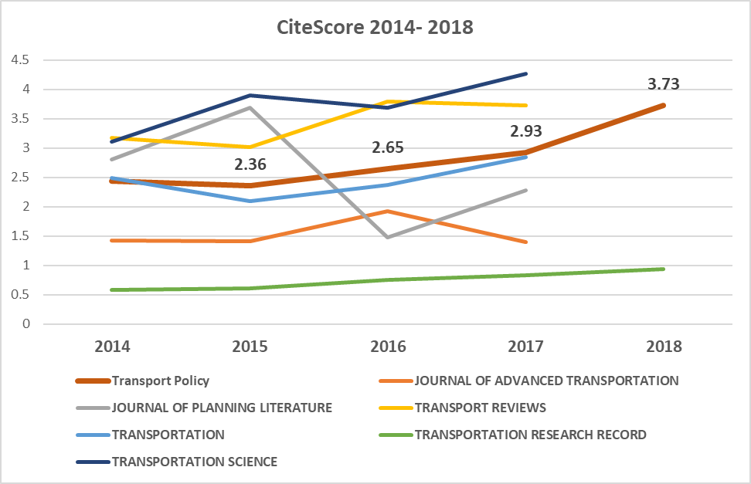
6. TP CitesScores Jumped 2.36 (2015) ➔3.73 (2018) (2013-17 docs published)

Slide 15
6. Acceptance Rates: 2018 Processed Papers Submitted vs. SI-VSI Papers
Regular Issue (submitted) papers: 23%
Special Issues; Virtual SI: 51%

Slide 16
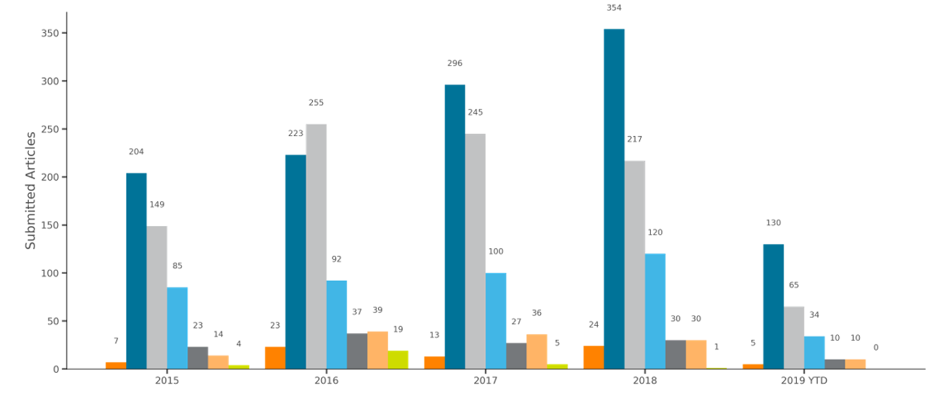
6. Submitted Articles by Region 2015 – 2019 (April)

Slide 17
7. Editor-in-Chief Report on Case Studies in Transport Policy – Professor Rosario Macario
Case Studies on Transport Policies
Performance
May 2019

Slide 18
7. Submitted Manuscripts and Editorial Outcomes

Slide 19
7. Submitted Articles by Region & Country

Slide 20
7. Accepted Articles by Region and Country

Slide 21
7. Top 10 Countries 2019 YTD: Submitted and Accepted Compared

Slide 22
7. Average Editorial Speed for Accepted and Rejected Articles

Slide 23
7. Impact Factor

Slide 24
7. CiteScore

Slide 25
7. Citations for All Articles

Slide 26
7. Next steps
Transfer from EVISE to EM (CSTP in the 1st league)
Indexation process;
Improve speed of publication in general;
Improve speed of publication for special issues coming from conferences;
Engage more reliable and performant reviewers

Slide 27
8. Membership
915 members registered by 21/05/19
65 different countries
75% Male 25% Female

Slide 28
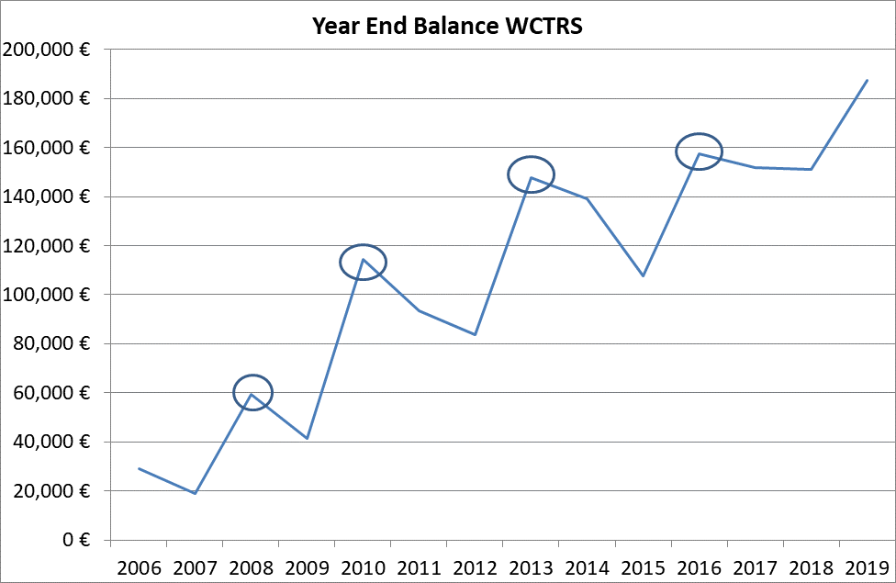
8. Finance

Slide 29
5b. Financial Projections & Test
Overall Projections (£)
 | Actuals | Forecast | Actuals | Forecast | Forecast | Forecast
Year | 2018 | 2019 | 2019 | 2020 | 2021 | 2022
Income | 36741 | 129761 | 77501 | 31100 | 74605 | 81506
Expenditure | 39654 | 67500 | 12362 | 41340 | 55300 | 71050
Final Balance | 130306 | 166385 | 195481 | 156145 | 175450 | 185906

Slide 30
8. Audit Report – Antonio Musso
The accompanying statements of WCTRS’ financial position of the year 2018 along with the related statements of activities and functional expenses performed in such reference period have been audited.
A set of documents has been analyzed, as follows:
financial statements and bank movements depicting the period Jan.–Dec. 2018;
past trends of the financial situation, accompanied by detailed actual figures of the year 2018;
a set of financial provisions, on a yearly basis, for the 2019-2022 reference period;
specific figures such as a comprehensive list of payments, bank reconciliation and paypal receipts providing objective evidence of the financial situation.
The audit has been performed in accordance with common auditing standards.
The financial statements present fairly, in all material respects, the financial position and performance of WCTRS of the whole year 2018 as represented by the results of its operations.

Slide 31
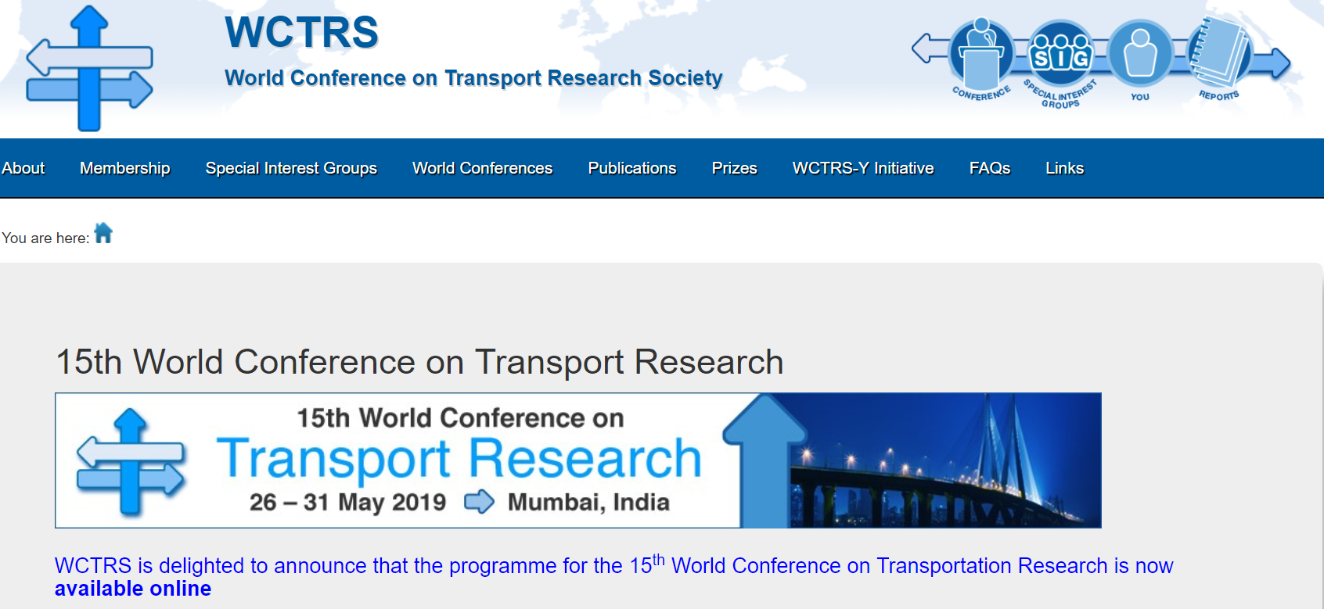
8. Other Matters
General Data Protection Regulations
Regular news brief
Periodic newsletter
www.wctrs-society.com
@WCTRSoc
https://www.facebook.com/wctrs.org/

Slide 32
9. Nomination and Election of President
Members of Presidential Nominating Committee
Professor Sergio Jara-Diaz
Professor Ali Huzzayin

Slide 33
10. Future Plans
1. Future Plans for the WCTRS
2. Nomination: WCTRS New Steering Committee
Members to the WCTRS General Assembly
28th May, 2019
by Tae H. Oum

Slide 34
Future Plans for WCTRS
Overall Objective of WCTRS: to Enhance our contribution to members & to the Global Society
• By promoting interchange of ideas via networking opportunities (academics, industry);
• By Contributing to citizens and economies of the world by doing important research which can make the world better place to live

Slide 35
How are we achieving these objectives ?
(A) Services to Researchers: we are doing quite well (except more geographic coverage is needed)
• WCTRS World Conferences
• Special Interest Groups (33+2 SIGs)
• Publication Activities:
Transport Policy and Case Studies on TP
Special Issues of journals: 20+ in this year
WCTRS Conference Procedia
• Paper prizes and Bursaries
• WCTRS Young Initiatives

Slide 36
How are we achieving these goals ?
(B) What about WCTRS contribution to better decision making (Industry; Policy makers); we are not doing well here
• Many WCTRS members individually contribute to better decision-making via consulting/advisory research
• But the WCTRS collectively have not done as much contribution as we could have done;
• WCTRS has now reached the time in point that we may be able to initiate research and education projects to contribute directly to the policy making and training experts

Slide 37
My Future Plan for WCTRS
(A) We will continue to strengthen most of the activities we have been doing well;
• Engaging in and expanding outreach activities to developing countries: Africa, Eastern Europe, Russia, India, SE Asia, Latin America
• We will also continue to strengthen WCTRS-Young Initiative which was initiated by Prof. Ali Huzayyin, and now successfully taken over by Prof. Laetitia Dablanc.

Slide 38
My Future Plan for WCTRS
(B) Some New Initiatives I will contemplate with the new STC Committee are:
• Urban Transport Efficiency Performance Benchmarking
• WCTRS Chartered Transport Analyst (and Supply Chain Management) Licence program
• Closer cooperation with International organizations to explore complementary relations: TRB, ITF, WB, AIIB, ICAO, UNFCCC, SLoCaT, etc.
• Build more North American membership base
• Attract more of the top class transport academics

Slide 39
Nomination of WCTRS New Steering Committee
Position | Name | Affiliation
President | Tae Hoon Oum | University of British Columbia, Canada
Past President | Yoshitsugu Hayashi | Chubu University, Japan
Secretary General | Greg Marsden | University of Leeds, UK
SCC Chair | Lori Tavasszy | Delft University of Technology, Netherlands
Operating Practice/Constitution | Ali Huzayyin | Cairo University, Egypt
Auditor | Antonio Musso | University of Rome, Italy
Legal Member | Michel Bierlaire | EPFL, Switzerland (WCTRS Registration)

Slide 40
President’s Advisory Council
STC Members:
Yoshitsugu Hayashi, immediate past president
Greg Marsden, Secretary General
Ali Huzayyin, Operating Practices & Constitution
Krishna Rao, WCTRS 2019 Conference Director
Haijun Huang, VP-Beihang Univ.,Beijing, China
STC Emeritus members:
Anthony May, Past WCTRS President
Werner Rothengatter, Past WCTRS President

Slide 41
Scientific Matters
Position | Name | Affiliation
SCC Chair | Lori Tavasszy | Delft University of Technology, Netherlands
SCC- VC SIGs | Hideki Nakamura | Nagoya University, Japan
SCC- VC Prizes | Sergio Jara-Diaz | Universidad de Chile, Chile
SCC- VC Publication | Anming Zhang | University of British Columbia, Canada
SCC- VC Conference | Gopal Patil (Asso. STC member) | IIT-Bombay, Mumbai, India
Editor-in-Chief, Transport Policy | (Tae Hoon Oum) | University of British Columbia, Canada
Editor-in-Chief, Case Studies in Transport Policy | Rosario Macario | CERIS Instituto Superior, Tecnico, Universidade de Liboa, TPR, Faculty of Applied Economics, University of Antwerp
Chair, WCTRS Book Series | Fusun Ulengin | Sabanci University, Turkey

Slide 42
16th WCTR Conference and Prizes
16th WCTR Conference
Position | Name | Affiliation
Conference Director | New | 2022 Conference Host
Vice Director (Asso STC)
Prizes
Position | Name | Affiliation
Chair of Conference Prize Sub-Committee | Sergio Jara-Diaz | University of Chile, Chile
Chair of Deputy Prize Sub-Committee | (Alain Bonnafous) | Université de Lyon II, France
Transport Policy Prize | (Tae Hoon Oum) | University of British Columbia, Canada

Slide 43
Int’l Organizational Relations
Position | Name | Affiliation
Chair | ???
KODATU Liaison | Ali Huzayyin | University of Cairo, Egypt
EASTS Liaison | JaeHak Oh | Korea Transport Institute, Korea
European Commission Liaison | Pierluigi Coppola | University of Rome Tor Vergata, Italy
ITF Liaison | Stephen Perkins | OECD-ITF Joint Transport Research Center
TRB Liaison | Jonathan Gifford | George Mason University, USA
TRB Liaison | Susan Shaheen | UC-Berkeley, USA
WB & International Funding Agencies | Jose Luis Irigoyen | Former WB VP, USA
UNFCCC & Climate Change | Holger Dalkmann | Former SLoCaT

Slide 44
Education - STC members
WCTRS-Young Initiatives:
Laetitia Dablanc, IFSTTAR, France
Advisor – Ali Huzayyin, Univ of Cairo, Egypt
Tasks to be negotiated:
Fusun Ulengin, Savanci Univ., Turkey
Rosario Macario – Distance Education

Slide 45
STC: New Initiatives
Shaoxuan Liu, Director, NSCIIC Institute and MIT-Global Scale Network China
(Haijun Huang), VP – Beihang Univ., TP -Editor

Slide 46
Membership and Marketing
Region | Name | Affiliation
China | Haixiao Pan | Tongji University, Shanghai, China
India | Ashish Verma (Gopal Patil) | IIS-Amadabhad (IIT-Bombay), India
Korea | JaeHak Oh | Korea Transport Institute, Korea
Japan and the Rest of Asia | Shinya Hanaoka | Tokyo Institute of Technology, Japan
USA | Jonathan Gifford | George Mason University, USA
Canada | Catherine Morency | Ecole Poltytechic Montreal, Canada
Latin America | ???
Western Europe | ???
East Europe and Russia | ???
Africa | ???
Middle East | ???
Organizational Membership drive: All STC/SCC members are responsible, administrative support by Secretary General (Greg Marsden), President (Tae Oum) and the immediate past president (Yoshi Hayashi).

Slide 47
Need for additional STC member appointments in 2019-2022
As indicated above, some sub-committees will be reformulated; and several task forces for initiating new projects will be formed;
At least, five sub-continental marketing and promotional STC members need to be found.
Therefore, as the new President I am seeking this GA’s authorization to allow me and the new STC to add 5-10 more STC members during 2019-2022 period.

Slide 48
Publicity (Newsletter and Digital Marketing)
Maria Attard, University of Malta
Shinya Hanaoka, Tokyo Institute of Technology
Masanobu Kii, (Associate STC member) Kagawa University, Japan
(Jennie Stones, WCTRS Secretariat, Leeds, NewsBriefs)
Need a few more serious volunteers to do media reporting of WCTRS members major research findings.
Need enthusiastic volunteers – Please contact tae.oum@ubc.ca

Slide 49
Organizational Membership Drive
Chair: Greg Marsden (Secretary General) especially for administrative support
immediate past president (Yoshi Hayashi) & all past presidents
President and all STC members

Slide 50
Some examples of new initiative to undertake in 2019-2022
Urban Transport Performance Benchmarking beginning with top 100 cities subway operational effiiciency benchmarking (need to form Task Forces);
(a) as WCTRS’ contributiton to the world
(b) as a means to engage urban transport policy makers and industry researcher/executives in the WCTRS process
Creating WCTRS Chartered Analyst Licence programs: beginning with (exact titles may change);
WCTRS Chartered Transport Analyst Licence program
WCTRS Supply Chain Management Analyst Licence program

Slide 51
WCTRS Honorary Emeritus Members
Position | Name | Country
Chair | Anthony May | UK
Member | Alain Bonnafous | France
Member | Yucel Candimir | Turkey
Member | Werner Rothengatter | Germany
Member | Roger Vickerman | UK
Member | Yoshitsugu Hayashi | Japan

Slide 52
감사합니다.

Slide 53
12. Fees and General Assembly
Background
For the period 2016 to 2019, the full membership fee is $150, with reduced fees of $90 for members from developing countries and $60 for registered students.
Fees will be reduced by one third for those joining on or after 1st January of the year following a WCTR, and by two thirds for those joining on or after 1st January in the second year following a WCTR.
At its meeting in July 2016, the GA gave the STC the power to raise the fees for 2019 to 2022 by at most 20% above these values.
Proposal
STC - We did not exercise that option so should ask the GA for this flexibility once again for the period 2022 to 2025.

Slide 54
Thank You

